Slide 1
Artificial Intelligence

Slide 2
Definition

Slide 3
Artificial Intelligence
Field in Computer Science
Creating intelligent machines

Slide 4
Artificial Intelligence
Field in Computer Science
Creating intelligent machines
There is no uniform definition of (artificial) intelligence in computer science!

Slide 5

What is intelligence?
How do you define intelligence or intelligent behaviour?

Slide 6
What is intelligence?
How do you define intelligence or intelligent behaviour?
Use your definition to decide how intelligent the following things are.
0
5
not intelligent
very intelligent

Slide 7

1. Toaster

Slide 8
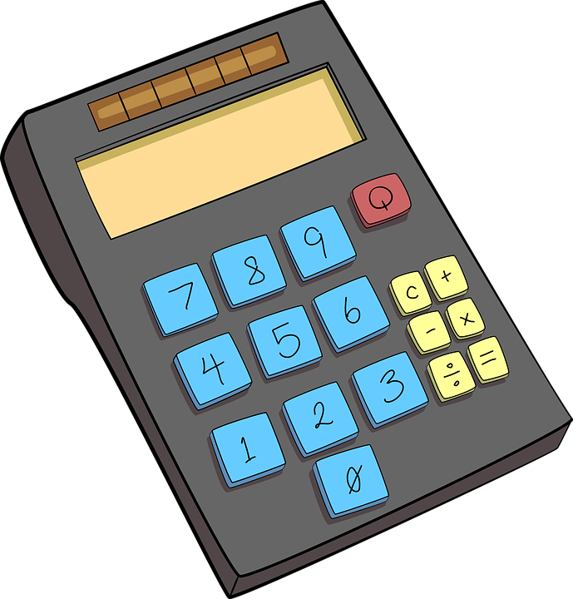
2. Calculator

Slide 9
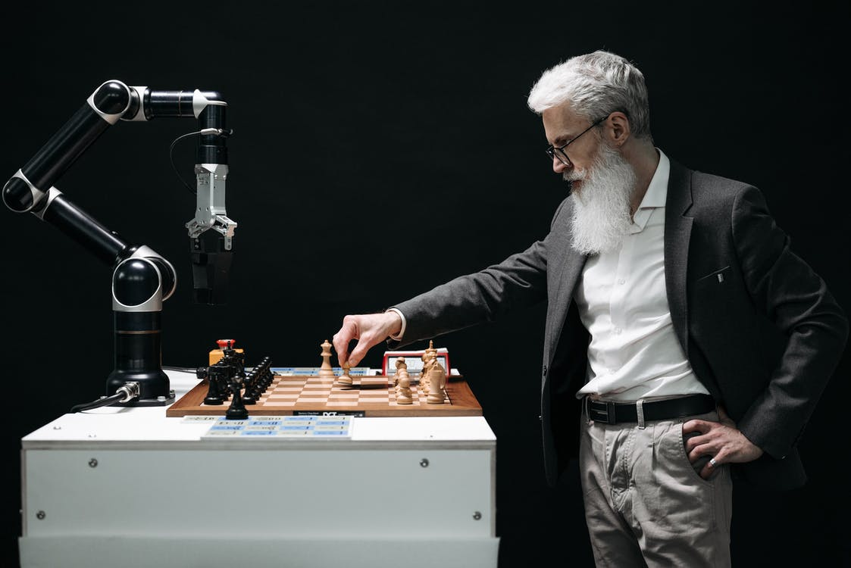
3. Chess playing robot

Slide 10

4. Chatbot

Slide 11
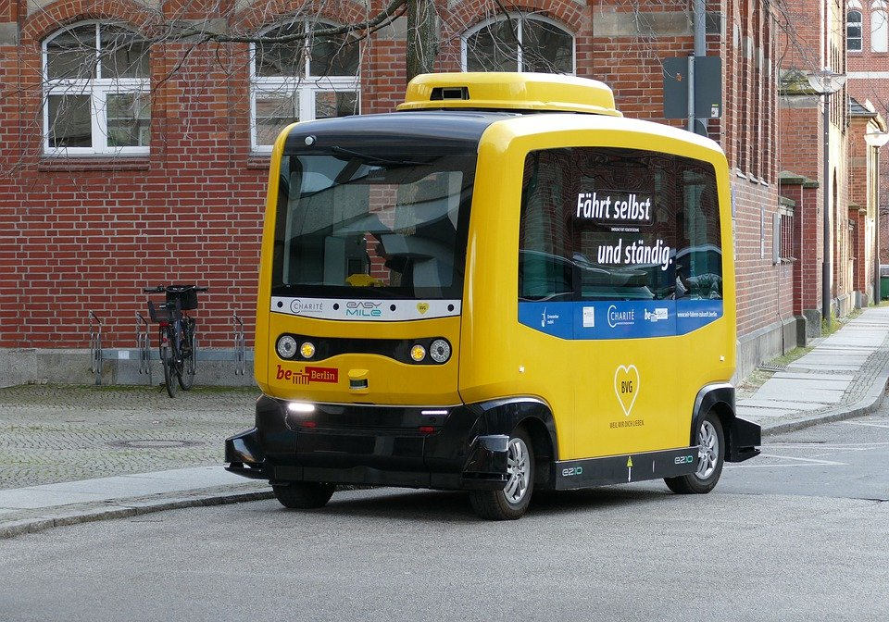
5. Self driving car

Slide 12
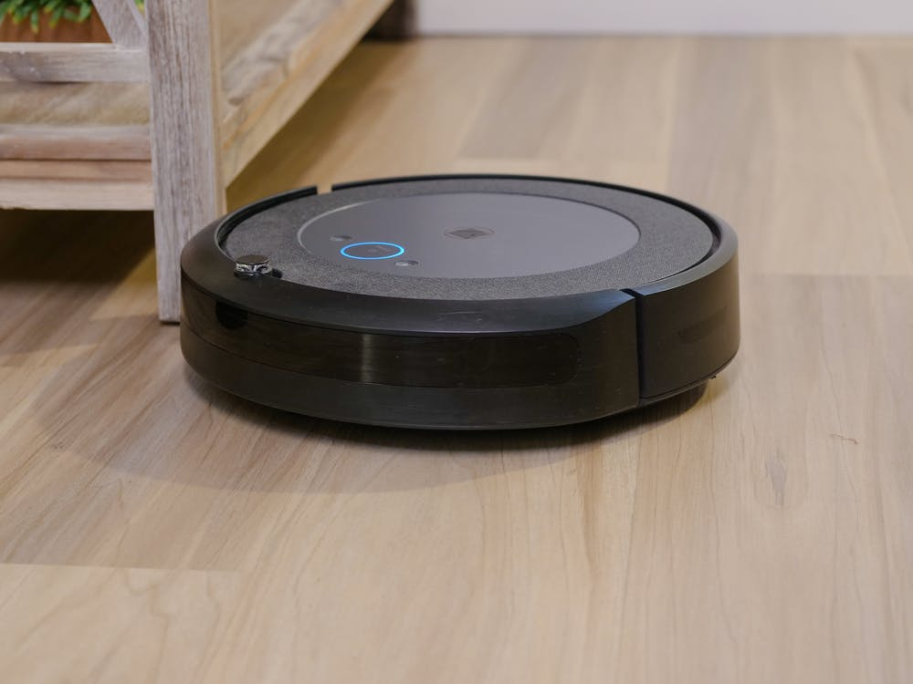
6. Cleaning robot

Slide 13
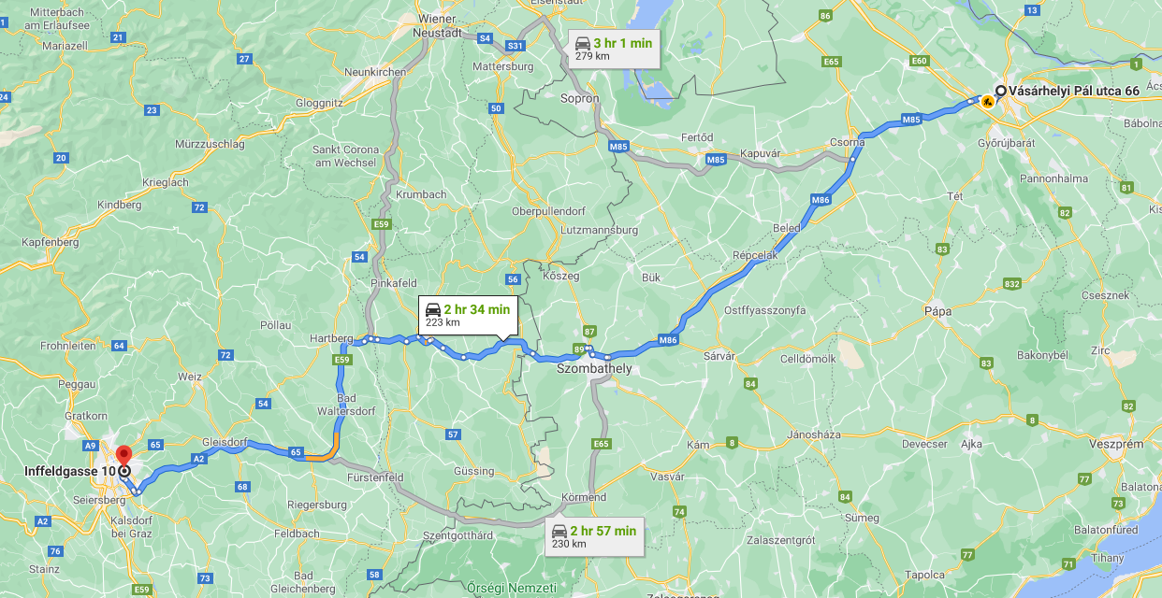
7. Navigation app

Slide 14

8. Earth-cleaning robot

Slide 15
What is intelligence?
Which of the things did you categorize as more intelligent?
Why those and not the others?
1
4
2
3
8
6
7
5

Slide 16
Possible Definitions
“A machine is intelligent, when it behaves as a human would in the same situation.”

Slide 17
Possible Definitions
“A machine is intelligent, when it behaves as a human would in the same situation.”
“Intelligence is the capability of a system to adapt its behaviour to meet its goals in a range of environments.”

Slide 18
Possible Definitions
“A machine is intelligent, when it behaves as a human would in the same situation.”
“Intelligence is the capability of a system to adapt its behaviour to meet its goals in a range of environments.”
“Intelligence is the computational part of the ability to achieve goals in the world.”

Slide 19
Possible Definitions
“A machine is intelligent, when it behaves as a human would in the same situation.”
“Intelligence is the capability of a system to adapt its behaviour to meet its goals in a range of environments.”
“Intelligence is the computational part of the ability to achieve goals in the world.”
“Intelligence is clearly a combination of the ability to 'figure things out on the spot' and the ability to retain and repeat things that have been figured out in the past.”

Slide 20
Map of AI

Slide 21
Map of AI
AI is a huge field and includes many subjects

Slide 22
Map of AI
AI is a huge field and includes many subjects
It can be categorized/structured in many ways

Slide 23
Map of AI
AI is a huge field and includes many subjects
It can be categorized/structured in many ways
The following shows one way of structuring AI related fields

Slide 24
Act
Move
Visualize
Sense
Image Recognition
Sensory Data
…
Think
Logic
Pathfinding
…
Artificial Intelligence
Neural Networks
Graphs
Learn
Supervised Learning
Reinforcement Learning
…
Know
Storing Knowledge
Databases
…

Slide 25

Think
Includes
Inference
Logic
Problem solving
…
Examples
Finding the shortest path
Calculating the value of actions in a game
Choosing the best action
Inferring true statements from facts

Slide 26

Know
Includes
Storing knowledge
Databases
Ontologies
…
Examples
Efficiently accessing stored knowledge
Storing relations between data
Finding good categories to split data into

Slide 27

Learn
Includes
Supervised learning
Reinforcement learning
Unsupervised learning
…
Examples
Training algorithms by using examples
Training algorithms by using reward and punishment
Adaptive (custom) advertisement

Slide 28

Sense
Includes
Anything to perceive the environment
Sensory data
Image recognition
…
Examples
Using ultrasonic sensors to detect objects
Using cameras to differentiate between people
Recognising spoken commands

Slide 29
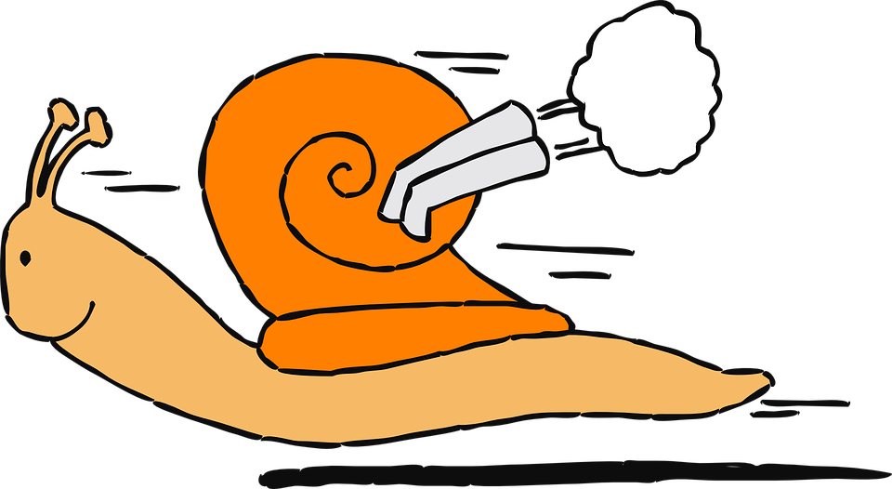
Act
Includes
Anything to interact with the environment
Examples
Showing results on a display
Driving around to the specified target
Signalling that there is not enough battery

Slide 30

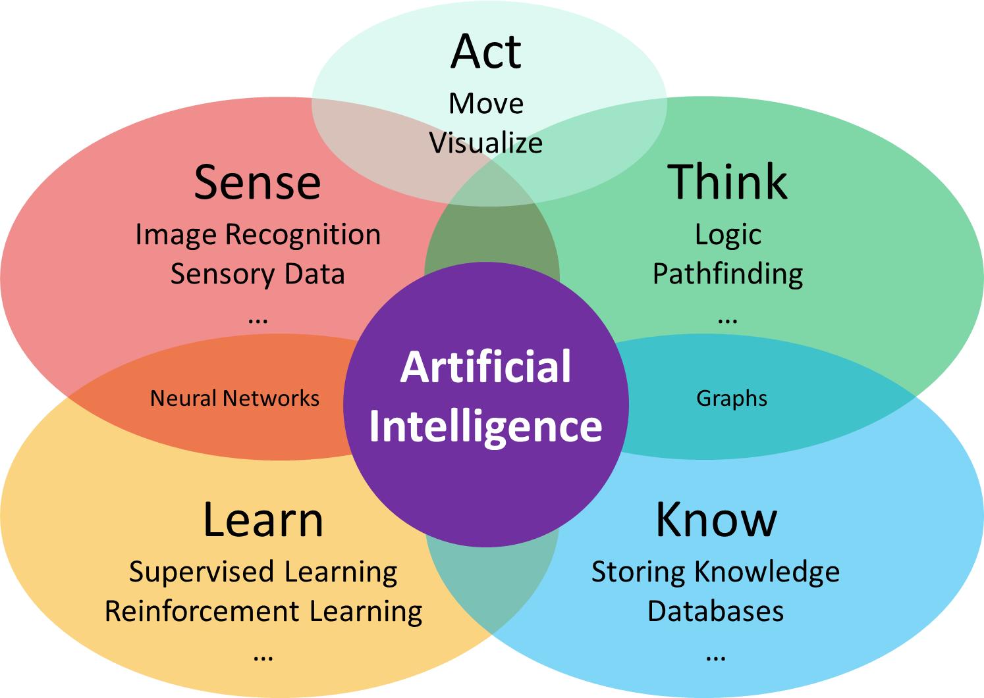

Categorise examples
Where on the map do the following examples belong to?
Multiple answers possible!
… belongs to
… might belong to
… does probably not belong to

Slide 31
1. Toaster

Slide 32
1. Toaster

Slide 33
3. Chess playing robot

Slide 34
3. Chess playing robot

Slide 35
5. Self driving car

Slide 36
5. Self driving car

Slide 37
6. Cleaning robot

Slide 38
6. Cleaning robot

Slide 39
Map of AI
There are a lot of fields in AI
Machine Learning is just one of them…
Most systems combine multiple fields

Slide 40
Possibilities and Limitations

Slide 41
Video
EN: https://youtu.be/alIq_wG9FNk
DE: https://youtu.be/92P0-mKMq9I
HU:

Slide 42
8. Earth-cleaning robot

Slide 43
8. Earth-cleaning robot

Slide 44
8. Earth-cleaning robot
What is the difference between Wall-E and the other AI examples?

Slide 45
Narrow vs general
AI systems can be grouped in two categories
Narrow AI
System that can efficiently solve a specific task

Slide 46
Narrow vs general
AI systems can be grouped in two categories
Narrow AI
System that can efficiently solve a specific task
General AI
System that can understand, reason and act successfully in the real world

Slide 47
Narrow vs general
AI systems can be grouped in two categories
Narrow AI
System that can efficiently solve a specific task
General AI
System that can understand, reason and act successfully in the real world
All current AI systems are narrow AIs!

Slide 48
Narrow vs general
AI systems can be grouped in two categories
Narrow AI
System that can efficiently solve a specific task
General AI
System that can understand, reason and act successfully in the real world
All current AI systems are narrow AIs!
They are really good at a specific task!

Slide 49
Narrow vs general
AI systems can be grouped in two categories
Narrow AI
System that can efficiently solve a specific task
General AI
System that can understand, reason and act successfully in the real world
All current AI systems are narrow AIs!
They are really good at a specific task!
But they don’t understand what they are doing…

Slide 50
Narrow vs general
AI systems can be grouped in two categories
Narrow AI
System that can efficiently solve a specific task
General AI
System that can understand, reason and act successfully in the real world
All current AI systems are narrow AIs!
They are really good at a specific task!
But they don’t understand what they are doing…
Most movies depict general AIs!

Slide 51
Narrow vs general
AI systems can be grouped in two categories
Narrow AI
System that can efficiently solve a specific task
General AI
System that can understand, reason and act successfully in the real world
All current AI systems are narrow AIs!
They are really good at a specific task!
But they don’t understand what they are doing…
Most movies depict general AIs!
Which we just can’t make in the foreseeable future…

Slide 52
Algorithms

Slide 53
Algorithm
List of instructions to solve a task

Slide 54
Algorithm
List of instructions to solve a task
Like a cooking recipe or assembly instructions

Slide 55
Algorithm
List of instructions to solve a task
Like a cooking recipe or assembly instructions
Has to be very precise, so it can not be misunderstood

Slide 56
Algorithm
List of instructions to solve a task
Like a cooking recipe or assembly instructions
Has to be very precise, so it can not be misunderstood
Try it yourself!

Slide 57
Data
AI Algorithms usually work with data
Data is information that can be stored on a device
Like images, texts, numbers, relations, …

Slide 58
Data
AI Algorithms usually work with data
Data is information that can be stored on a device
Like images, texts, numbers, relations, …
An image of a tree
The height of a person
A field of a board game
The name of an object
…
Can you find further examples of data?

Slide 59
Data
AI Algorithms usually work with data
Data is information that can be stored on a device
Like images, texts, numbers, relations, …
An image of a tree
The height of a person
A field of a board game
The name of an object
…
Can you find further examples of data?
What was data in your algorithm example?

Slide 60
Questions?
01001000 01100101 01101100 01110000 00100001

Slide 61

Up next
Take a more in depth look into how
some of these algorithms actually work!

